Slide 1




Banking System Project
Code Hitters,
Mahesh
Nithin
Shweta

Slide 2
Project Overview
A secure web-based banking system developed using Django.
Provides core banking functions with integrated personal finance tools.
Includes a machine learning model to predict loan eligibility.

Slide 3
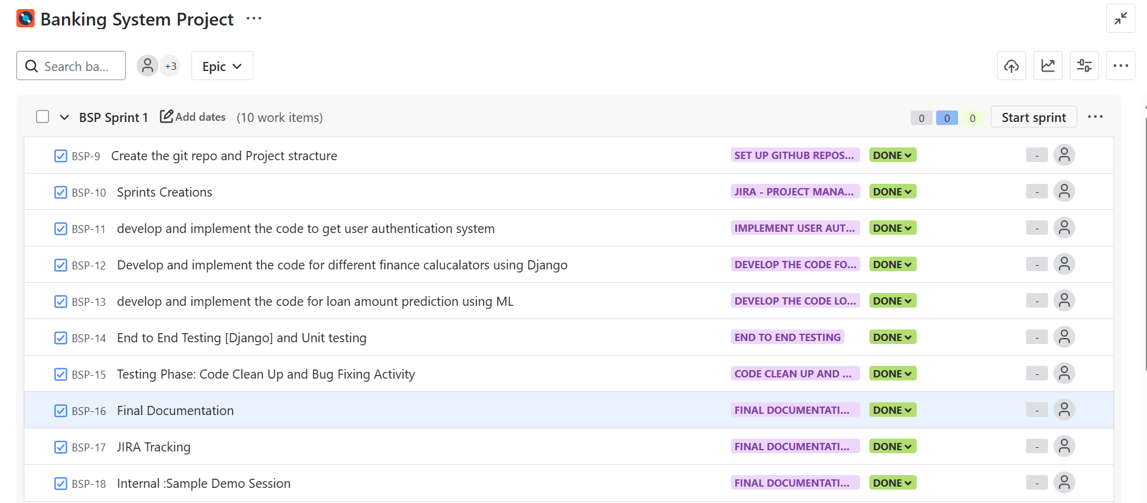
Project management : JIRA

Slide 4
Key Features
✔ User Registration & Login
✔ Deposits and Withdrawals
✔ Balance Inquiry & Transaction History
✔ Loan Amount Prediction (ML-based)
✔ 10 Financial Calculators (e.g., EMI, FD, SIP)

Slide 5
Technology Stack
🔹 Backend: Django (Python)
🔹 Frontend: HTML, CSS, Bootstrap (template-based)
🔹 Database: SQLite (development)
🔹 Machine Learning: scikit-learn
🔹 Deployment: PythonAnywhere (Tried)

Slide 6
Financial Calculators
1. EMI Calculator
2. Fixed Deposit (FD) Calculator
3. Recurring Deposit (RD) Calculator
4. Simple Interest
5. Compound Interest
6. SIP (Systematic Investment Plan)
7. PPF
8. Retirement
9. Education Planning
10. Loan Repayment

Slide 7
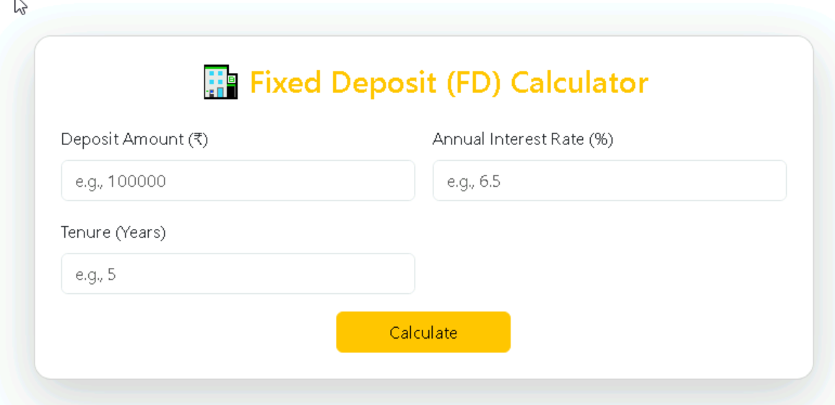
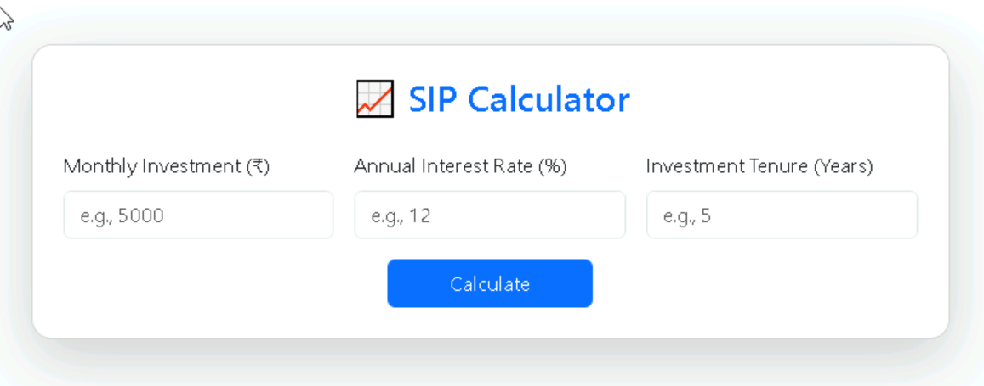

Slide 8
ML: Loan Amount Prediction
🎯 Predicts the maximum eligible loan amount for a user.
Inputs: Age, Income, Credit Score, Dependents,Existing loan amount, Loan Tenure, etc.
Library used: pandas, numpy, scikit-learn joblib
Algorithm Used: Random Forest Regressor
Trained using a custom dataset and integrated via Pickle model.
Real-time prediction from web form.

Slide 9
Inputs: Age, Income, Credit Score, Dependents, Existing loan amount, Loan Tenure, etc.
Algorithm Used: Random Forest Regressor

Slide 10
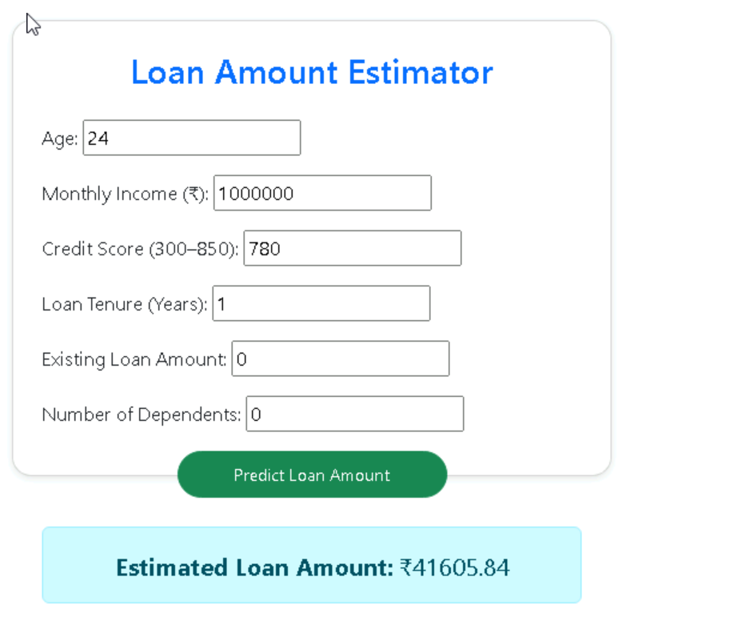

Slide 11
Security Features
🔐 Password hashing (Django auth)
🔐 Input validation & CSRF protection
🔐 Session management
🔐 Admin authentication for control

Slide 12
Deployment Strategy
🎯 platform: PythonAnywhere
⚙ Steps include:
- Upload project files
- Configure WSGI
- Set up virtualenv & dependencies
- Map static files and set environment variables

Slide 13
Future Enhancements
📈 Multi-user transaction support (real-time banking)
📊 Dashboard with data visualization
💳 Integration with payment APIs
📱 Mobile-friendly UI/UX design
🔎 Improved ML model accuracy

Slide 14
DEMO OF OUR PROJECT

Slide 15
Thank You
We appreciate your time and attention.
Looking forward to your feedback.
Q&A

